Slide 1

Lecture 3 SQL(Structured Query Language)
(Chapter 3&4)
Prof. Jihong Guan
Email: jhguan@tongji.edu.cn
Department of Computer Science and Technology
Tongji University

Slide 2
Outline of the Course
Part 0: Overview
Ch1: Introduction
☞ Part 1 Relational Databases
Ch2: Relational model (data model, relational algebra)
Ch3&4: SQL(Structured Query Language)
Ch5: Advanced SQL
Part 2 Database Design
Ch6: Database design based on E-R model
Ch7: Relational database design
Part 3 Application Design & Development
Ch8: Complex data types
Ch9: Application development
Part 4 Big data analytics
Ch10: Big data
Ch11: Data analytics
Part 5 Data Storage & Indexing
Ch12: Physical storage system
Ch13: Data storage structure
Ch14: Indexing
Part 6 Query Processing & Optimization
Ch15: Query processing
Ch16: Query optimization
Part 7 Transaction Management
Ch17: Transactions
Ch18: Concurrency control
Ch19: Recovery system
Part 8 Parallel & Distributed Database
Ch20: Database system architecture
Ch21-23: Parallel & distributed storage, query processing & transaction processing
Part 9
DB Platform:OceanBase, MongoDB, Neo4J

Slide 3
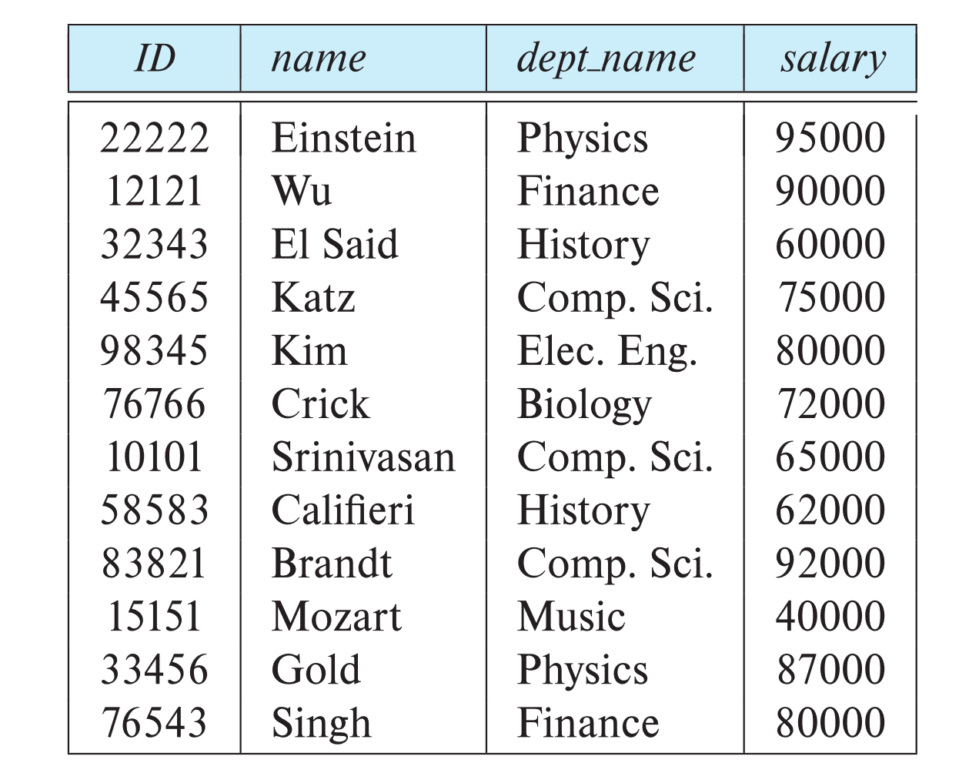
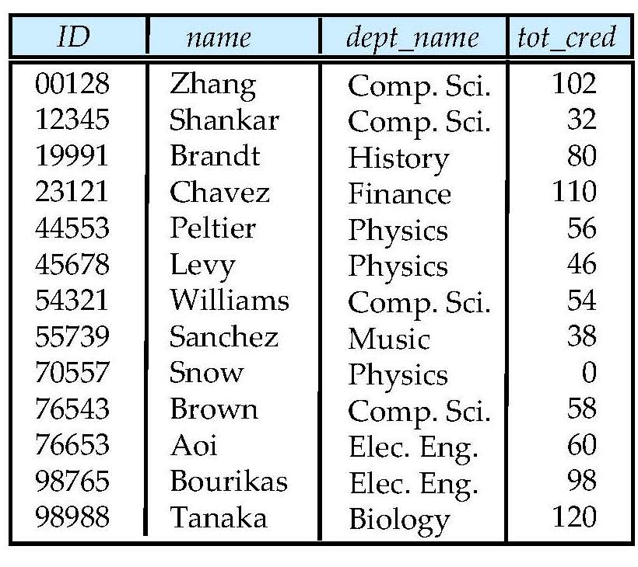
University Database
Instructor table
Student table

Slide 4
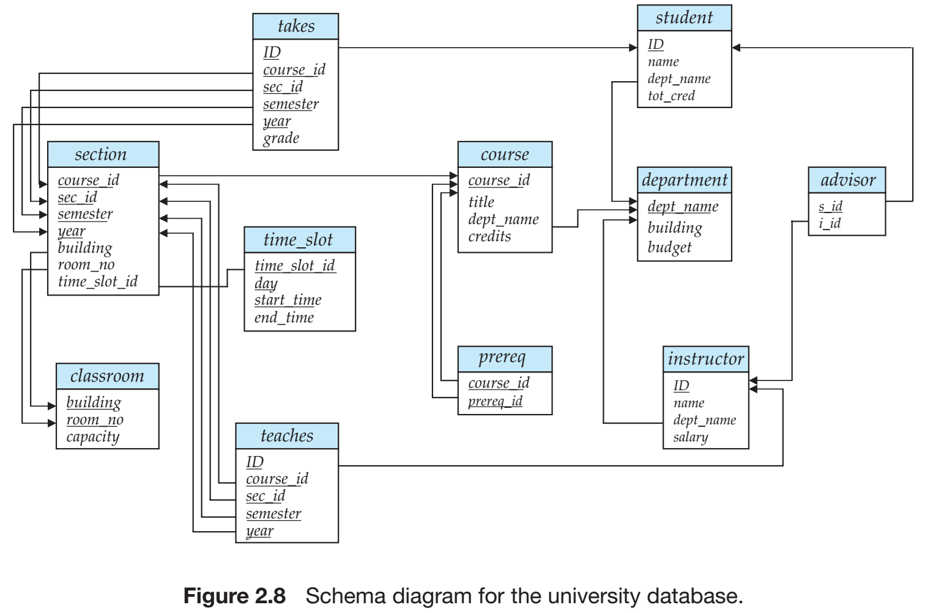
University Database
Relational Model
SQL
Database Design
Storage & Query
Transactions

Slide 5
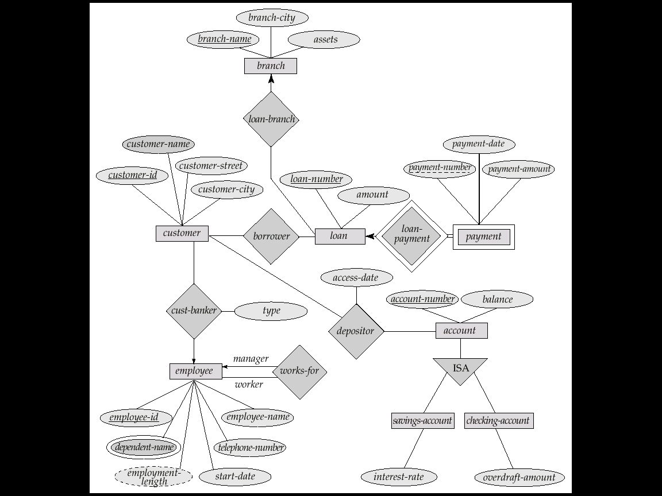
E-R Diagram for a Banking Enterprise
account-branch
Weak entity sets
multi-valued attribute
derived attribute

Slide 6
The Banking Schema
branch = (branch_name, branch_city, assets)
customer = (customer_id, customer_name, customer_street, customer_city)
loan = (loan_number, amount)
account = (account_number, balance)
employee = (employee_id, employee_name, telephone_number, start_date)
dependent_name = (employee_id, dname) (derived from a multivalued attribute)
account_branch = (account_number, branch_name)
loan_branch = (loan_number, branch_name)
borrower = (customer_id, loan_number)
depositor = (customer_id, account_number, access_date)
cust_banker = (customer_id, employee_id, type)
works_for = (worker_employee_id, manager_employee_id)
payment =(loan_number,payment_number,payment_date,payment_amount)
savings_account = (account_number, interest_rate)
checking_account = (account_number, overdraft_amount)

Slide 7
Outline (Chapter 3)
☞ Overview of the SQL
SQL Data Definition
Basic Structure of SQL Queries
Additional Basic Operations
Set Operations
Null Values
Aggregate Functions
Nested Subqueries
Modification of the Database

Slide 8
Overview of the SQL Query Language
IBM Sequel language developed as part of System R project at the IBM San Jose Research Laboratory in the early 1970s
Renamed Structured Query Language (SQL)
ANSI (美国国家标准学会) and ISO (国际标准化组织) standard SQL:
SQL-86
SQL-89
SQL-92
SQL:1999, 2003, 2006, 2008
Commercial systems offer most, if not all, SQL-92 features, plus varying feature sets from later standards and special proprietary features
Not all examples here may work on the particular system

Slide 9
Structured Query Language (SQL)
SQL语言包含
数据定义语言（Data definition language，DDL)
Relation schemas
Integrity constraints
View definition
Authorization
数据操纵语言（Data manipulation language，DML)
Queries
Insertion, Deletion, Updates
Transaction processing

Slide 10
Outline
Overview of the SQL
☞ SQL Data Definition
Basic Structure of SQL Queries
Additional Basic Operations
Set Operations
Null Values
Aggregate Functions
Nested Subqueries
Modification of the Database

Slide 11
Data Definition Language (DDL)
Allows the specification of not only a set of relations but also information about each relation, including:
The schema for each relation
The domain of values associated with each attribute
Integrity constraints
The set of indices to be maintained for each relations
Security and authorization information for each relation
The physical storage structure of each relation on disk

Slide 12
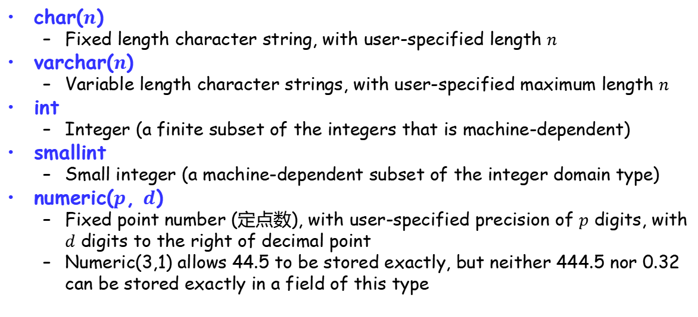
Domain Types in SQL
char($n$)
Fixed length character string, with user-specified length $n$
varchar($n$)
Variable length character strings, with user-specified maximum length $n$
int
Integer (a finite subset of the integers that is machine-dependent)
smallint
Small integer (a machine-dependent subset of the integer domain type)
numeric($p$, $d$)
Fixed point number (定点数), with user-specified precision of $p$ digits, with $d$ digits to the right of decimal point
Numeric(3,1) allows 44.5 to be stored exactly, but neither 444.5 nor 0.32 can be stored exactly in a field of this type
Notes:
The char data type stores fixed length strings. Consider, for example, an attribute A of type char(10). If we store a string “Avi” in this attribute, 7 spaces are appended to the string to make it 10 characters long. In contrast, if attribute B were of type varchar(10), and we store “Avi” in attribute B, no spaces would be added. When comparing two values of type char, if they are of different lengths extra spaces are automatically added to the shorter one to make them the same size, before comparison. When comparing a char type with a varchar type, one may expect extra spaces to be added to the varchar type to make the lengths equal, before comparison; however, this may or may not be done, depending on the database system. As a result, even if the same value “Avi” is stored in the attributes A and B above, a comparison A=B may return false. We recommend you always use the varchar.
numeric(3,1) allows 44.5 to be stored exactly, but neither 444.5 nor 0.32 can be stored exactly in a field of this type. type instead of the char type to avoid these problems.

Slide 13
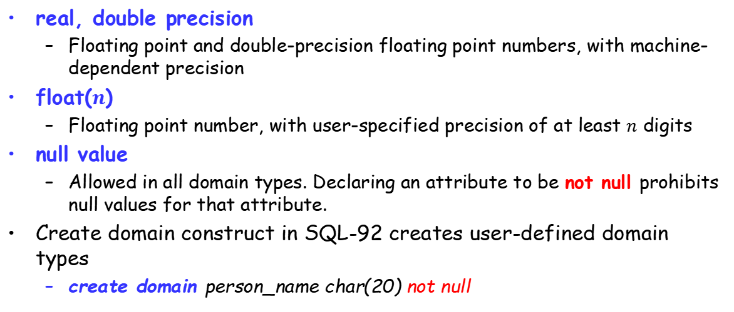
Domain Types in SQL (Cont.)
real, double precision
Floating point and double-precision floating point numbers, with machine-dependent precision
float($n$)
Floating point number, with user-specified precision of at least $n$ digits
null value
Allowed in all domain types. Declaring an attribute to be not null prohibits null values for that attribute.
Create domain construct in SQL-92 creates user-defined domain types
create domain person_name char(20) not null

Slide 14
Date/Time Types in SQL (Cont.)
date
Dates, containing a (4 digit) year, month and date
E.g., date ‘2020-9-30’
time
Time of day, in hours, minutes and seconds.
E.g., time ’09:25:30’ time ’09:25:30.75’
Timestamp
date plus time of day
E.g., timestamp ‘2020-9-30 09:25:30.75’

Slide 15
Date/Time Types in SQL (Cont.)
Interval: period of time
Subtracting a date/time/timestamp value from another gives an interval value, e.g., Interval ‘1’ day
Interval values can be added to date/time/timestamp values
Extract values of individual fields from date/time/timestamp
E.g., extract (year from r.starttime)
Cast string types to date/time/timestamp
E.g., cast <string-valued-expression> as date

Slide 16
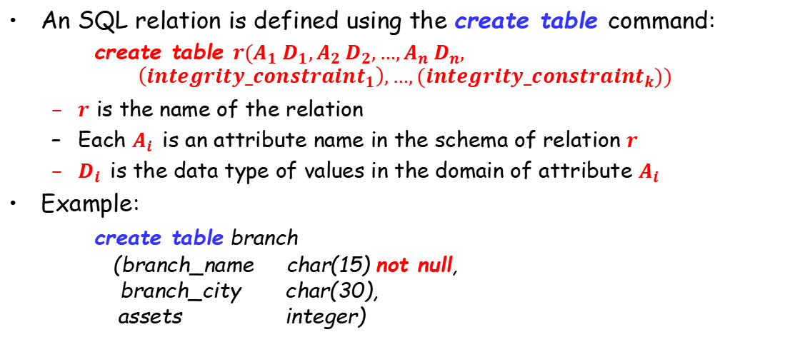
Basic Schema Definition
An SQL relation is defined using the create table command:
create table $r(A_{1} D_{1},A_{2} D_{2},…,A_{n} D_{n},$
$$\left({integrity_constraint}_{1}\right),…,({integrity_constraint}_{k}))$$
$r$ is the name of the relation
Each $A_{i}$ is an attribute name in the schema of relation $r$
$D_{i}$ is the data type of values in the domain of attribute $A_{i}$
Example:
create table branch (branch_name char(15) not null, branch_city char(30), assets integer)

Slide 17
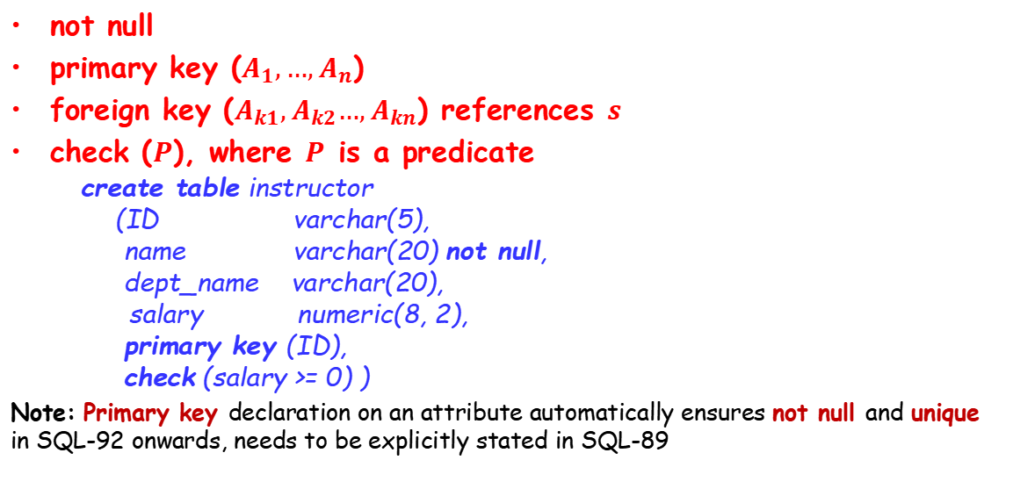
Integrity Constraints in Creating Tables
not null
primary key ($A_{1},…,A_{n}$)
foreign key ($A_{k1},A_{k2}…,A_{kn}$) references $s$
check ($P$), where $P$ is a predicate
create table instructor (ID varchar(5), name varchar(20) not null, dept_name varchar(20),
salary numeric(8, 2), primary key (ID), check (salary >= 0) )
Note: Primary key declaration on an attribute automatically ensures not null and unique in SQL-92 onwards, needs to be explicitly stated in SQL-89

Slide 18
Basic Insertion and Deletion of Tuples
Newly created table is empty
Add a new tuple to table instructor
insert into instructor values (‘10211', ‘Smith’, ‘Computer Science’, 66000)
Insertion fails if any integrity constraint is violated
Delete all tuples from table instructor
delete from instructor

Slide 19
Drop and Alter Table Constructs
The drop table command deletes all information about the dropped relation from the database
The alter table command is used to add attributes to an existing relation
alter table r add A D
All tuples in the relation are assigned null as the value for the new attribute.
The alter table command can also be used to drop attributes of a relation alter table r drop A
Dropping of attributes not supported by many databases

Slide 20
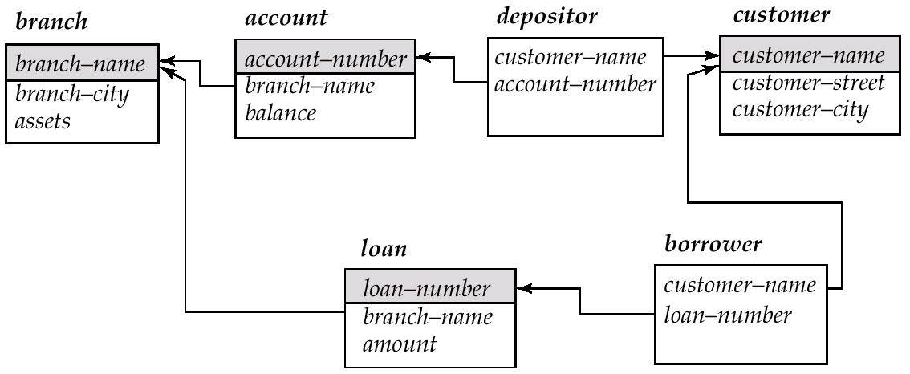
Schema Used in Examples

Slide 21
Schema Used in Examples

Slide 22
Outline
Overview of the SQL
SQL Data Definition
Basic Structure of SQL Queries
Additional Basic Operations
Set Operations
Null Values
Aggregate Functions
Nested Subqueries
Modification of the Database

Slide 23
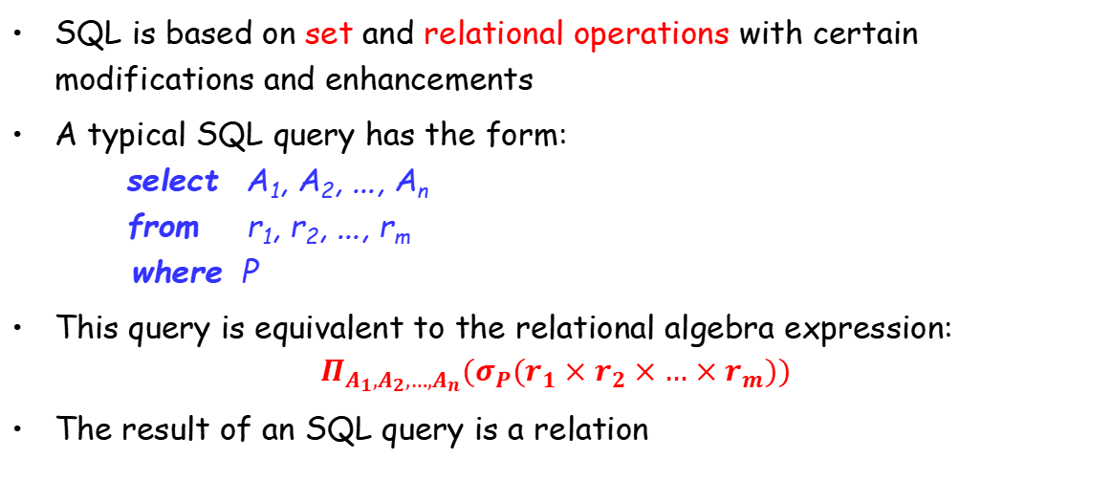
Basic Structure of SQL Queries
SQL is based on set and relational operations with certain modifications and enhancements
A typical SQL query has the form: select A₁, A₂, ..., A_{n} from r₁, r₂, ..., r_{m} where P
This query is equivalent to the relational algebra expression:
$$Π_{A_{1},A_{2},…,A_{n}}(σ_{P}(r_{1}×r_{2}×…×r_{m}))$$
The result of an SQL query is a relation

Slide 24
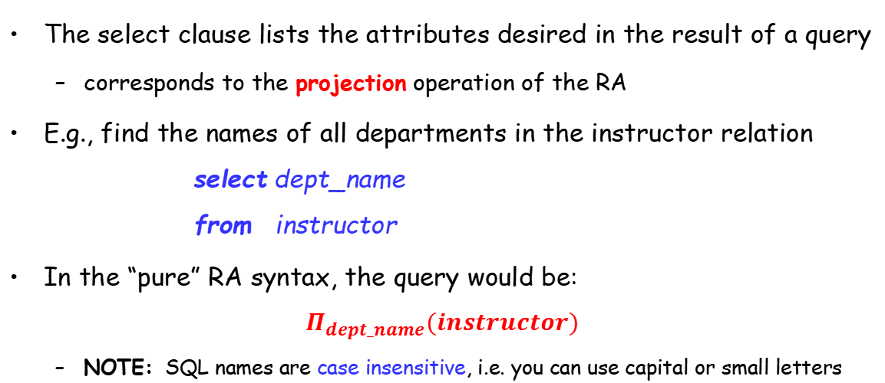
The Select Clause
The select clause lists the attributes desired in the result of a query
corresponds to the projection operation of the RA
E.g., find the names of all departments in the instructor relation select dept_name from instructor
In the “pure” RA syntax, the query would be:
$$Π_{dept_name}(instructor)$$
NOTE: SQL names are case insensitive, i.e. you can use capital or small letters

Slide 25
The select Clause (Cont.)
SQL allows duplicates in relations. To eliminate duplicates, insert the keyword distinct after select
Find the names of all departments in the instructor relation, and remove duplicates
select distinct dept_name from instructor
The keyword all specifies that duplicates should not be removed by default
select all dept_name from instructor

Slide 26
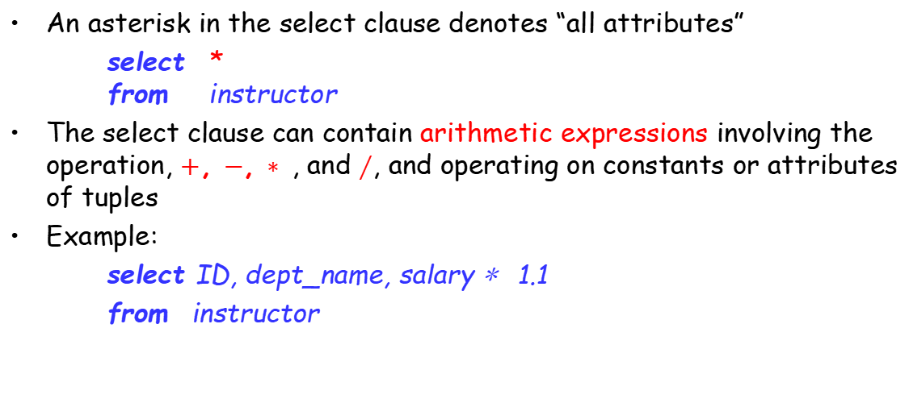
The select Clause (Cont.)
An asterisk in the select clause denotes “all attributes”
select * from instructor
The select clause can contain arithmetic expressions involving the operation, $+$, $−$, $∗$ , and $∕$, and operating on constants or attributes of tuples
Example:
select ID, dept_name, salary ∗ 1.1
from instructor

Slide 27
The where Clause
The where clause specifies conditions that the result must satisfy
correspond to the selection predicate of the RA (relational algebra)
E.g., to find all loan numbers for loans made at the Perryridge branch with loan amount greater than $1200. select loan_number from loan where branch_name = ‘Perryridge’ and amount > 1200
Comparison results can be combined using the logical connectives and, or, and not
Comparison can be applied to results of arithmetic expressions
Notes:
Predicate：断言
In contrast, the attributes name and building appear in only one of the relations, and therefore do not need to be prefixed by the relation name.

Slide 28
The where Clause (Cont.)
SQL includes a between comparison operator
E.g. find the loan numbers of those loans with loan amount between $90,000 and $100,000
select loan_number from loan where amount between 90000 and 100000

Slide 29
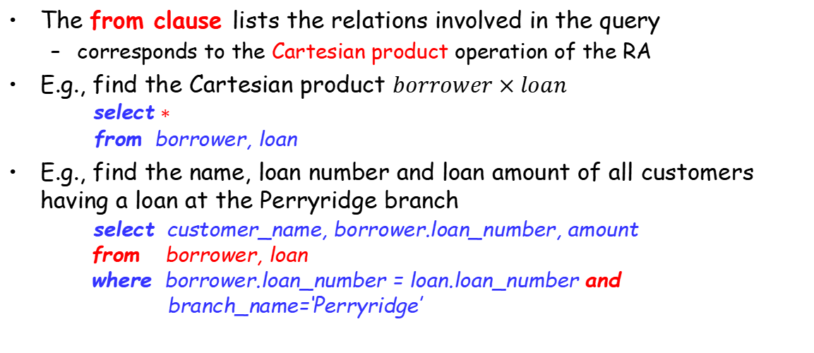
The from Clause
The from clause lists the relations involved in the query
corresponds to the Cartesian product operation of the RA
E.g., find the Cartesian product $borrower×loan$
select $∗$
from borrower, loan
E.g., find the name, loan number and loan amount of all customers having a loan at the Perryridge branch
select customer_name, borrower.loan_number, amount from borrower, loan where borrower.loan_number = loan.loan_number and
branch_name=‘Perryridge’

Slide 30
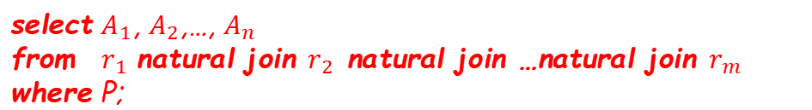
The Natural Join
select $A_{1}$, $A_{2}$,…, $A_{n}$
from $r_{1}$ natural join $r_{2}$ natural join …natural join $r_{m}$
where P;
select name, course_id
from instructor natural join teaches;
select name, title
from instructor natural join teaches, course
where teaches.course_id = course.course_id;
Notes:
Notice that we do not repeat those attributes that appear in the schemas of both relations; rather they appear only once. Notice also the order in which the attributes are listed: first the attributes common to the schemas of both relations, second those attributes unique to the schema of the first relation, and finally, those attributes unique to the schema of the second relation.

Slide 31
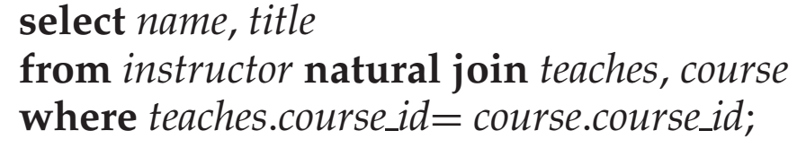
join … using(…)
natural join of instructor and teaches
(ID, name, dept_name, salary, course_id, sec_id)
course
(course_id, title, dept_name, credits)
结果不等
结果相等
Notes:
This query would then omit all (instructor name, course title) pairs where the instructor teaches a course in a department other than the instructor’s own department. The previous query, on the other hand, correctly outputs such pairs.
=where teaches.course_id=course.course_id and dept_name = course.dept_name;
结果不等是因为结果属性有重复（指定course_id，那么重复的就是dept_name）

Slide 32
Outline
Overview of the SQL
SQL Data Definition
Basic Structure of SQL Queries
Additional Basic Operations
Set Operations
Null Values
Aggregate Functions
Nested Subqueries
Modification of the Database

Slide 33
The Rename Operation
The SQL allows renaming relations and attributes using the as clause: old_name as new_name
Find the name, loan_number and loan_amount of all customers; rename the column name loan_number as loan_id:
select customer_name, borrower.loan_number as loan_id, amount
from borrower, loan
where borrower.loan_number = loan.loan_number
Notes:
This naming convention requires that the relations that are present in the from clause have distinct names. This requirement causes problems in some cases, such as when information from two different tuples in the same relation needs to be combined. In Section 3.4.1, we see how to avoid these problems by using the rename operation.

Slide 34
Tuple Variables
Tuple variables are defined in the from clause via the use of the as clause
Find the customer names and their loan numbers for all customers having a loan at some branch
select customer_name, T.loan_number, S.amount from borrower as T, loan as S where T.loan_number = S.loan_number
Find the names of all branches that have greater assets than some branch located in Brooklyn.
select distinct T.branch_name from branch as T, branch as S where T.assets > S.assets and S.branch_city = ‘Brooklyn’

Slide 35
String Operations
SQL includes a string-matching operator for comparisons on character strings.
percent (%): The % character matches any substring
underscore (_): The _ character matches any character
like/not like: Find the names of all customers whose street includes (or not) the substring “Main”
select customer_name from customer where customer_street like ‘%Main%’
Match the name “Main%”要匹配的字符中有百分号的情况，需要转义
like ‘Main\%’； escape ‘\’
“*” denote “all attributes” : select instructor.*
SQL supports a variety of string operations such as
Concatenation（串联） (using “||”)
converting from upper to lower case (and vice versa)
finding string length, extracting substrings, etc.
Notes:
SQL specifies strings by enclosing them in single quotes, for example, ’Computer’. A single quote character that is part of a string can be specified by using two single quote characters; for example, the string “It’s right” can be specified by “It”s right”. 这里’因为需要，两边就用双引号。

Slide 36
Order the Display of Tuples
List in alphabetic order the names of all customers having a loan in Perryridge branch
select distinct customer_name from borrower, loan where borrower.loan_number = loan.loan_number and branch_name = ‘Perryridge’ order by customer_name
We may specify desc for descending order or asc for ascending order, for each attribute; ascending order is the default.
select *
from loan
order by amount desc, loan-number asc

Slide 37
Where Clause Predicates
SQL includes a between\not between comparison operator
Example: find the names of all instructors with salary between $90,000 and $100,000
select name from instructor where salary between 90000 and 100000
Tuple comparison
select name, course_id from instructor, teaches where (instructor.ID, dept_name) = (teaches.ID, ’Biology’);
select name, course_id
from instructor, teaches
where instructor.ID=teaches.ID and dept_name=‘Biology’
等价

Slide 38
Outline
Overview of the SQL
SQL Data Definition
Basic Structure of SQL Queries
Additional Basic Operations
☞ Set Operations
Null Values
Aggregate Functions
Nested Subqueries
Modification of the Database

Slide 39
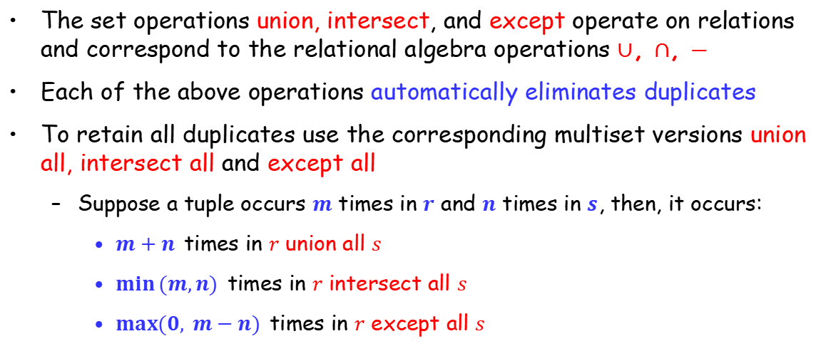
Set Operations
The set operations union, intersect, and except operate on relations and correspond to the relational algebra operations $∪$, $∩$, $−$
Each of the above operations automatically eliminates duplicates
To retain all duplicates use the corresponding multiset versions union all, intersect all and except all
Suppose a tuple occurs $m$ times in $r$ and $n$ times in $s$, then, it occurs:
$m+n$ times in $r$ union all $s$
$\min{(m,n)}$ times in $r$ intersect all $s$
$max⁡(0, m−n)$ times in $r$ except all $s$

Slide 40
Set Operations
Find all customers who have a loan, an account, or both:
(select customer_name from depositor) union [all] (select customer_name from borrower)
Find all customers who have both a loan and an account.
(select customer_name from depositor) intersect [all] (select customer_name from borrower)
Find all customers who have an account but no loan.
(select customer_name from depositor) except [all] (select customer_name from borrower)

Slide 41
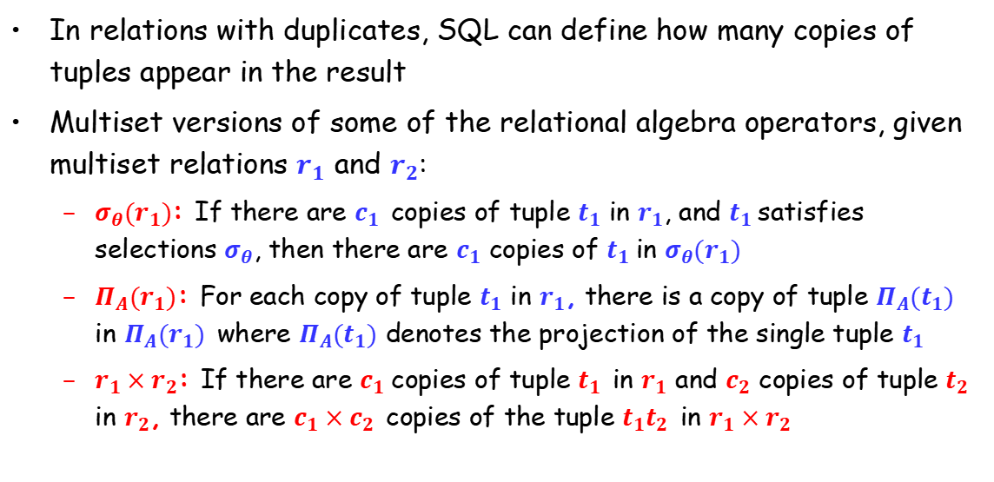
Duplicates
In relations with duplicates, SQL can define how many copies of tuples appear in the result
Multiset versions of some of the relational algebra operators, given multiset relations $r_{1}$ and $r_{2}$:
$σ_{θ}(r_{1})$: If there are $c_{1}$ copies of tuple $t_{1}$ in $r_{1}$, and $t_{1}$satisfies selections $σ_{θ}$, then there are $c_{1}$ copies of $t_{1}$in $σ_{θ}(r_{1})$
$Π_{A}(r_{1})$: For each copy of tuple $t_{1}$ in $r_{1}$, there is a copy of tuple $Π_{A}(t_{1})$ in $Π_{A}(r_{1})$ where $Π_{A}(t_{1})$ denotes the projection of the single tuple $t_{1}$
$r_{1}×r_{2}$: If there are $c_{1}$copies of tuple $t_{1}$ in $r_{1}$ and $c_{2}$ copies of tuple $t_{2}$ in $r_{2}$, there are $c_{1}×c_{2}$ copies of the tuple $t_{1}t_{2}$ in $r_{1}×r_{2}$

Slide 42
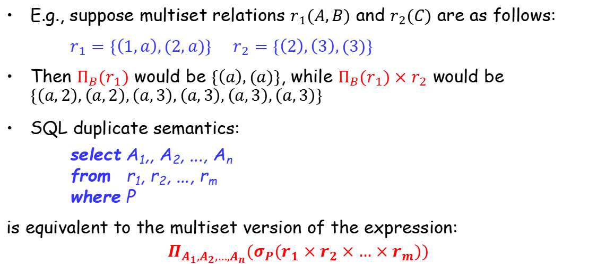
Duplicates (Cont.)
E.g., suppose multiset relations $r_{1}(A,B)$ and $r_{2}(C)$ are as follows:
$r_{1}=\{\left(1,a\right),(2,a)\}$ $r_{2}=\{\left(2\right),\left(3\right),(3)\}$
Then $Π_{B}(r_{1})$ would be $\{\left(a\right),(a)\}$, while $Π_{B}(r_{1})×r_{2}$ would be $\{\left(a,2\right),\left(a,2\right),\left(a,3\right),\left(a,3\right),\left(a,3\right),\left(a,3\right)\}$
SQL duplicate semantics:
select A₁,, A₂, ..., A_{n} from r₁, r₂, ..., r_{m} where P
is equivalent to the multiset version of the expression:
$$Π_{A_{1},A_{2},…,A_{n}}(σ_{P}(r_{1}×r_{2}×…×r_{m}))$$

Slide 43
Outline
Overview of the SQL
SQL Data Definition
Basic Structure of SQL Queries
Additional Basic Operations
Set Operations
☞ Null Values
Aggregate Functions
Nested Subqueries
Modification of the Database

Slide 44
Null Values
It is possible for tuples to have a null value, signifies an unknown value or that a value does not exist
The predicate is null can be used to check for null values
select loan_number from loan where amount is null
The result of any arithmetic expression involving null is null
E.g. 5 + null returns null
Aggregate functions simply ignore null values
Notes:
{(’A’,null),(’A’,null)}, are treated as being identical, even if some of the attributes have a null value. a comparison “null=null” would return unknown,rather than true.

Slide 45
Null Values and Three Valued Logic
Any comparison with null returns unknown
E.g. 5 < null or null <> null or null = null
Three-valued logic (三值逻辑) using the truth value unknown:
OR: (unknown or true) = true, (unknown or false) = unknown (unknown or unknown) = unknown
AND: (true and unknown) = unknown, (false and unknown) = false, (unknown and unknown) = unknown
NOT: (not unknown) = unknown
“P is unknown” evaluates to true if predicate P evaluates to unknown
Result of where clause predicate is treated as false if it evaluates to unknown

Slide 46
Null Values and Aggregates
Calculate the sum of all loan amounts
select sum (amount) from loan
Above statement ignores null amounts
Result is null if there is no non-null amount
All aggregate operations except count(*) ignore tuples with null values on the aggregated attributes
Notes:
As a result of null values being ignored, the collection of values may be empty. The count of an empty collection is defined to be 0, and all other aggregate operations return a value of null when applied on an empty collection

Slide 47
Outline
Overview of the SQL
SQL Data Definition
Basic Structure of SQL Queries
Additional Basic Operations
Set Operations
Null Values
☞ Aggregate Functions
Nested Subqueries
Modification of the Database

Slide 48
Aggregate Functions
These functions operate on a set of values of a column of a relation, and return a value
avg: average value
min: minimum value
max: maximum value
sum: sum of values
count: number of values
Notes:
The input to sum and avg must be a collection of numbers, but the other operators can operate on collections of nonnumeric data types, such as strings, as well.

Slide 49
Aggregate Functions (Cont.)
Find the average account balance at the Perryridge branch
select avg (balance) from account where branch_name = ‘Perryridge’
Find the number of tuples in the customer relation
select count (*) from customer
Find the number of depositors in the bank
select count (distinct customer_name) from depositor

Slide 50
Aggregate Functions – Group By
Find the number of depositors for each branch
select branch_name, count (distinct customer_name) from depositor, account where depositor.account_number = account.account_number group by branch_name
Note: Attributes in select clause outside of aggregate functions must appear in group by list
/*erroneous query*/
select dept_name, ID, avg(salary)
from instructor
group by dept_name
Notes:
There are circumstances where we would like to apply the aggregate function not only to a single set of tuples, but also to a group of sets of tuples; we specify this wish in SQL using the group by clause. The attribute or attributes given in the group by clause are used to form groups. Tuples with the same value on all attributes in the group by clause are placed in one group.
When an SQL query uses grouping, it is important to ensure that the only attributes that appear in the select statement without being aggregated are those that are present in the group by clause. In other words, any attribute that is not present in the group by clause must appear only inside an aggregate function if it appears in the select clause, otherwise the query is treated as erroneous. Each instructor in a particular group (defined by dept name) can have a different ID, and since only one tuple is output for each group, there is no unique way of choosing which ID value to output. As a result, such cases are disallowed by SQL.

Slide 51
Aggregate Functions – Having Clause
At times, it is useful to state a condition that applies to groups rather than to tuples.
E.g., find the names of all branches where the average account balance is more than $1,200.
select branch_name, avg (balance) from account group by branch_name having avg (balance) > 1200
Note
predicates in the having clause are applied after the information of groups whereas
predicates in the where clause are applied before forming groups

Slide 52
Aggregate Functions – Having Clause
E.g., find the average balance for each customer who lives in Harrison and has at least three accounts
select depositor.customer_name, avg (balance) from depositor, account, customer where depositor.account_number=account.account_number
and depositer.customer_name=customer.customer_name
and customer_city=‘Harrison’
group by depositor.customer_name having count(distinct depositor.account_number) >=3
Notes:
1. As was the case for queries without aggregation, the from clause is first evaluated to get a relation. 2. If a where clause is present, the predicate in the where clause is applied on the result relation of the from clause. 3. Tuples satisfying the where predicate are then placed into groups by the group by clause if it is present. If the group by clause is absent, the entire set of tuples satisfying the where predicate is treated as being in one group. 4. The having clause, if it is present, is applied to each group; the groups that do not satisfy the having clause predicate are removed. 5. The select clause uses the remaining groups to generate tuples of the result of the query, applying the aggregate functions to get a single result tuple for each group

Slide 53
Outline
Overview of the SQL
SQL Data Definition
Basic Structure of SQL Queries
Additional Basic Operations
Set Operations
Null Values
Aggregate Functions
☞ Nested Subqueries
Modification of the Database

Slide 54
Nested Subqueries（嵌套子查询）
SQL provides a mechanism for the nesting of subqueries
A subquery is a select-from-where expression that is nested within another query in the from clause
A common use of subqueries is to perform
tests for set membership
make set comparisons
determine set cardinality
Notes:
Cardinality：基数

Slide 55
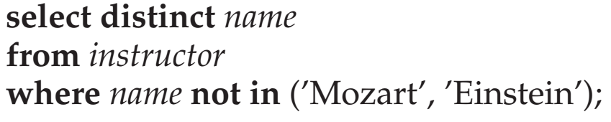
Set Membership
Find all customers who have both an account and a loan at the bank
select distinct customer_name from borrower where customer_name in (select customer_name
from depositor)
Find all customers who have a loan but do not have an account at the bank
select distinct customer_name from borrower where customer_name not in (select customer_name from depositor)

Slide 56
Set Membership (Cont.)
Find all customers who have both an account and a loan at the Perryridge branch
select distinct customer_name from borrower, loan where borrower.loan_number=loan.loan_number and branch_name=“Perryridge” and (branch_name, customer_name) in (select branch_name, customer_name from depositor, account where depositor.account_number =account.account_number)

Slide 57
Set Comparison
Find all branches that have greater assets than some branch located in Brooklyn
select distinct T.branch_name from branch as T, branch as S where T.assets > S.assets and S.branch_city = ‘Brooklyn’
Same query using >some clause
select branch_name from branch where assets > some (select assets from branch where branch_city = ‘Brooklyn’)

Slide 58

Definition of Some Clause
$F<comp>some r⇔∃ t∈r$ such that ($F<comp>t$), where <comp> can be: $<,≤,>,≥,=,≠$
0
(5< some
5
) = true
(read: 5 < some tuple in the relation)
6
(5< some
0
) = false
5
(= some) ≡ in
However,
(≠ some) ≡ not in
0
(5 = some
) = true
5
0
(5 ≠ some
) = true (since 0 ≠ 5)
5

Slide 59

Definition of all Clause
$F<comp>all r ⇔∀t ∈r (F<comp>t)$
0
(5< all
) = false
5
6
6
(5< all
) = true
(≠ all) ≡ not in
However, (= all) ≡ in
10
4
(5 = all
5
) = false
(5 ≠ all
) = true (since 5 ≠ 4 and 5 ≠ 6)
4
6

Slide 60
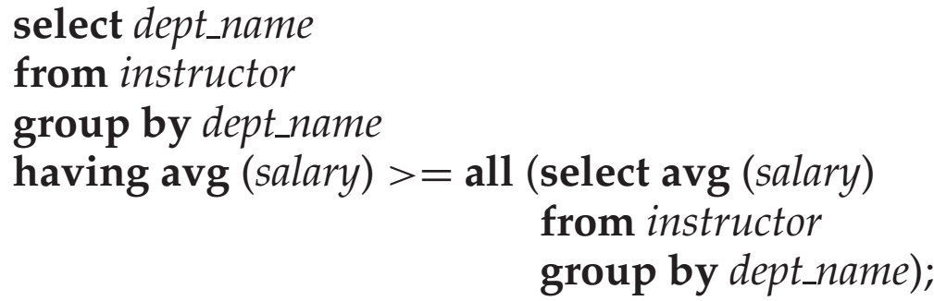
Example
Find the names of all branches that have greater assets than all branches located in Brooklyn.
select branch_name from branch where assets > all (select assets from branch where branch_city = ‘Brooklyn’)
平均工资最高的系
Notes:
平均工资最高的系

Slide 61
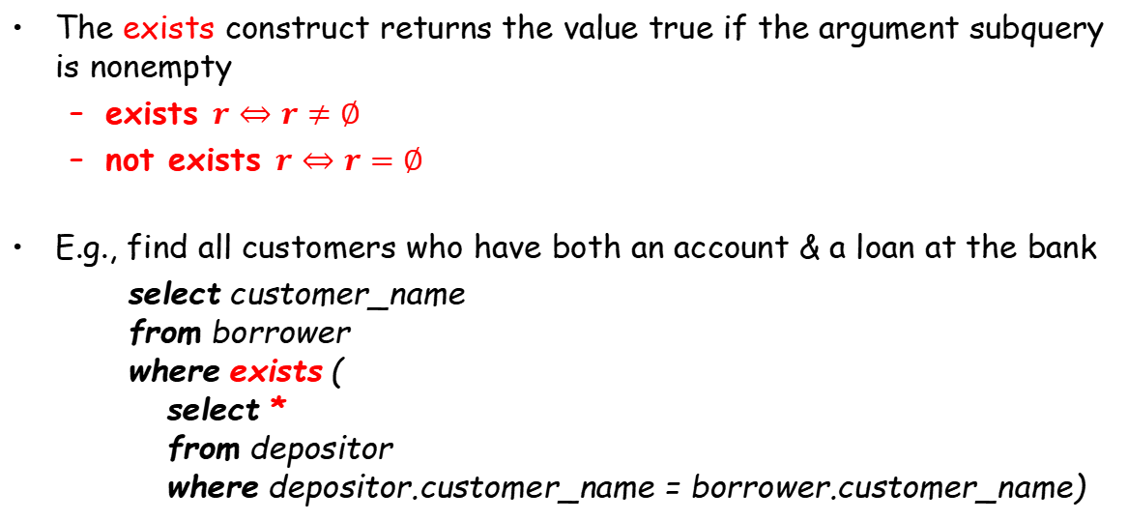
Test for Empty Relations
The exists construct returns the value true if the argument subquery is nonempty
exists $r⇔r≠∅$
not exists $r⇔r=∅$
E.g., find all customers who have both an account & a loan at the bank
select customer_name from borrower where exists ( select * from depositor where depositor.customer_name = borrower.customer_name)

Slide 62
Test for Empty Relations
Find all customers who have both an account and a loan at the bank
select customer_name from borrower where exists ( select * from depositor where depositor.customer_name = borrower.customer_name)
select distinct customer_name from borrower where customer_name in (select customer_name
from depositor)
select distinct customer_name from borrower, loan where borrower.loan_number = loan.loan_number and (branch_name, customer_name) in (select branch_name, customer_name from depositor, account where depositor.account_number = account.account_number)

Slide 63
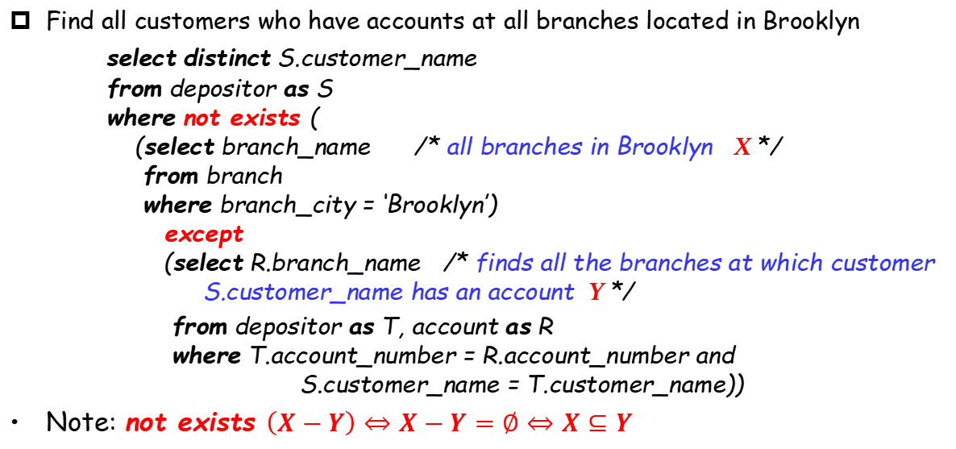
Test for Empty Relations (Cont.)
Find all customers who have accounts at all branches located in Brooklyn
select distinct S.customer_name from depositor as S where not exists ( (select branch_name /* all branches in Brooklyn X */ from branch where branch_city = ‘Brooklyn’) except (select R.branch_name /* finds all the branches at which customer S.customer_name has an account Y */
from depositor as T, account as R where T.account_number = R.account_number and S.customer_name = T.customer_name))
Note: not exists $\left(X−Y\right)⇔X−Y=∅⇔X⊆Y$
Notes:
Note: Cannot write this query using = all and its variants
因为=all的左边是一条记录，而这里是两个集合

Slide 64
Test for Empty Relations (Cont.)
Write “relation A contains relation B” as “not exists (B except A).”
E.g., find all students who have taken all courses offered by the Biology department
select distinct S.ID, S.name
from student as S
where not exists ((select course_id
from course
where dept_name = ‘Biology’)
except
(select T.course_id
from takes as T
where S.ID=T.ID))

Slide 65
Test for Absence of Duplicate Tuples
The unique construct tests whether a subquery has any duplicate tuples in its result
E.g., find all customers who have at most one account at the Perryridge branch
select T.customer_name
from depositor as T
where unique (
select R.customer_name from account, depositor as R where T.customer_name = R.customer_name and R.account_number = account.account_number and account.branch_name = ‘Perryridge’)

Slide 66
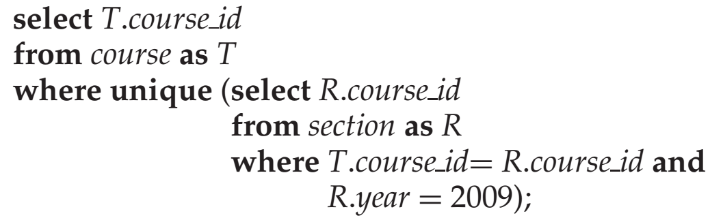
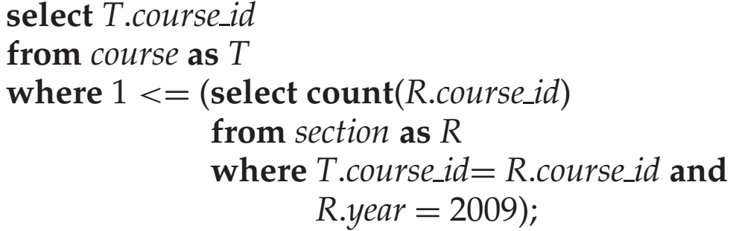

Examples
找出所有在2009年最多开设一次的课程
等价
$$>=$$
Notes:
Note that if a course is not offered in 2009, the subquery would return an empty result, and the unique predicate would evaluate to true on the empty set. 小于号应该改为大于号

Slide 67
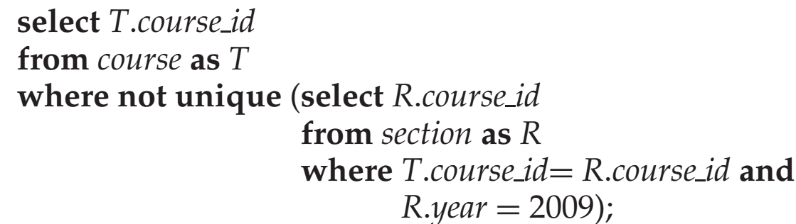
Examples
Find all customers who have at least two accounts at the Perryridge branch.
select distinct T.customer_name
from depositor T
where not unique(
select R.customer_name
from account, depositor as R
where T.customer-name = R.customer_name and R.account-number = account.account_number and account.branch_name = ‘Perryridge’)
找出所有在2009年至少开设两次的课程
Notes:
Since the test t1 = t2 fails if any of the fields of t1 or t2 are null, it is possible for unique to be true even if there are multiple copies of a tuple, as long as at least one of the attributes of the tuple is null.

Slide 68
Views
In some cases, it is not desirable for all users to see the entire logical model (that is, all the actual relations stored in the database.)
Consider a person who needs to know a customer’s name, loan number and branch name, but has no need to see the loan amount. This person should see a relation described by
(select customer_name, borrower.loan_number, branch_name from borrower, loan where borrower.loan_number = loan.loan_number )
A view provides a mechanism to hide certain data from the view of certain users. Any relation that is not of the conceptual model but is made visible to a user as a “virtual relation” is called a view.
Notes:
Any relation that is not of the conceptual model?不是存储的概念模型的表，而是把SQL查询语句存储下来的虚拟的表

Slide 69
View Definition
A view is defined using the create view statement which has the form
create view v as < query expression >
where <query expression> is any legal SQL expression. The view name is represented by v.
Once a view is defined, the view name can be used to refer to the virtual relation that the view generates
When a view is created, the query expression is stored in the database; the expression is substituted into queries using the view

Slide 70
Example
A view consisting of branches and their customers
create view all_customer as (select branch_name, customer_name from depositor, account where depositor.account_number = account.account_number)
union (select branch_name, customer_name from borrower, loan where borrower.loan_number = loan.loan_number)
Find all customers of the Perryridge branch
select customer_name from all_customer where branch_name = ‘Perryridge’

Slide 71
Derived Relations
Derived Relations
Find the average account balance of those branches where the average account balance is greater than $1200.
Note: we do not need to use the having clause, since we compute the temporary (view) relation result in the from clause, and the attributes of result can be used directly in the where clause
select branch_name, avg_balance from (select branch_name, avg (balance)
from account group by branch_name) as result (branch_name, avg_balance) where avg_balance > 1200
select branch_name, avg (balance) from account group by branch_name having avg (balance) > 1200

Slide 72
Derived Relations (Cont.)
Find the maximum total balance across all branches
select max(tot_balance) from (select branch_name, sum (balance) from account group by branch_name) as branch_total (branch_name, tot_balance)

Slide 73
With Clause
With clause allows views to be defined locally to a query, rather than globally. Analogous to procedures in a programming language
Find all accounts with the maximum balance.
with max_balance(value) as select max(balance) from account
select account_number from account, max_balance where account.balance = max_balance.value

Slide 74
Complex Query using with Clause
Find all branches where the total account deposit is greater than the average of the total account deposits at all branches
with branch_total (branch_name, value) as select branch_name, sum (balance) from account group by branch_name
with branch_total_avg (value) as select avg (value) from branch_total
select branch_name from branch_total, branch_total_avg where branch_total.value >= branch_total_avg.value
Notes:
However, using nested subqueries would have made the query harder to read and understand. The with clause makes the query logic clearer; it also permits a view definition to be used in multiple places within a query

Slide 75
Scalar Subquery
Scalar subquery is used where a single value is expected
List all departments along with the number of instructors in each department
select dept_name, (select count(*) from instructor where department.dept_name = instructor.dept_name) as num_instructors from department;
Runtime error if subquery returns more than one tuple

Slide 76
Outline
Overview of the SQL
SQL Data Definition
Basic Structure of SQL Queries
Additional Basic Operations
Set Operations
Null Values
Aggregate Functions
Nested Subqueries
☞ Modification of the Database

Slide 77
Modification of the Database – Deletion
Delete all accounts at every branch located in Needham city
delete from account where branch_name in (select branch_name from branch where branch_city = ‘Needham’)
delete from depositor where account_number in (select account_number from branch, account where branch_city = ‘Needham’ and branch.branch_name = account.branch_name)

Slide 78
Example
Delete the records of all accounts with balances below the average at the bank
delete from account where balance < (select avg(balance) from account)
Note: as we delete tuples from account, the average balance changes
Solution used in SQL:
First, compute avg balance and find all tuples to delete
Next, delete all tuples found above (without recomputing avg or retesting the tuples)
Notes:
Performing all the tests before performing any deletion is important—if some tuples are deleted before other tuples have been tested, the average salary may change, and the final result of the delete would depend on the order in which the tuples were processed!

Slide 79
Modification of the Database – Insertion
Add a new tuple to account
insert into account values (‘A-9732’, ‘Perryridge’,1200)
or equivalently
insert into account (branch_name, balance, account_number) values (‘Perryridge’, 1200, ‘A-9732’)
Add a new tuple to account with balance setting to null
insert into account values (‘A-777’,‘Perryridge’, null)

Slide 80
Modification of the Database – Insertion
Provide as a gift for all loan customers of the Perryridge branch, i.e., a $200 saving account. Let the loan number serve as the account number for the new saving account
insert into account select loan_number, branch_name, 200 from loan where branch_name = ‘Perryridge’ insert into depositor select customer_name, loan_number from loan, borrower where loan.loan_number = borrower.loan_number
and branch_name = ‘Perryridge’
The select from where statement is fully evaluated before any of its results are inserted into the relation. Otherwise, queries like insert into table1 select * from table2 would cause problems
Notes:
might insert an infinite number of tuples, if the primary key constraint on student were absent. Without the primary key constraint, the request would insert the first tuple in student again, creating a second copy of the tuple. Since this second copy is part of student now, the select statement may find it, and a third copy would be inserted into student. The select statement may then find this third copy and insert a fourth copy, and so on, forever. Evaluating the select statement completely before performing insertions avoids such problems.

Slide 81
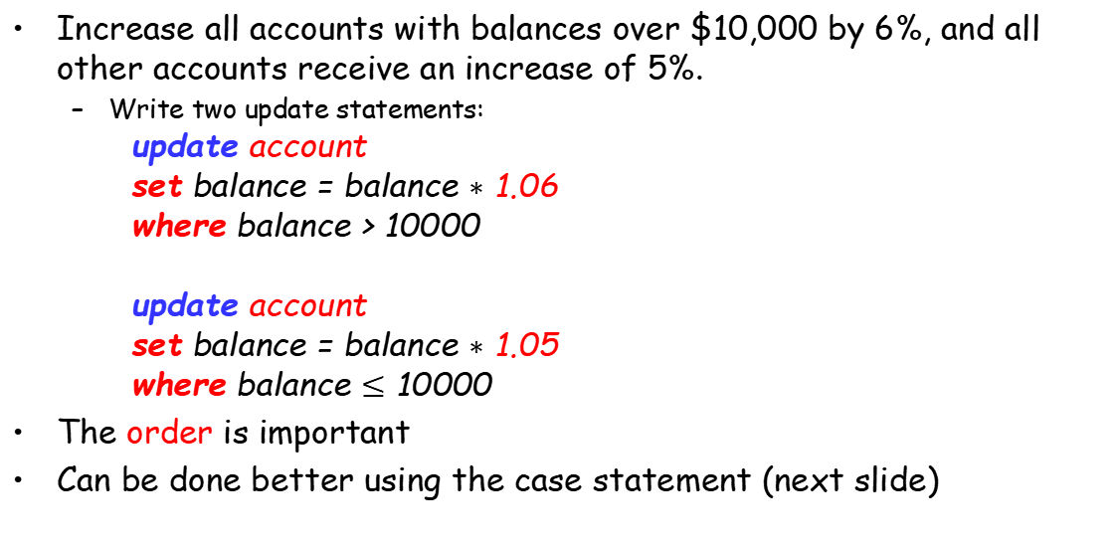
Modification of the Database – Updates
Increase all accounts with balances over $10,000 by 6%, and all other accounts receive an increase of 5%.
Write two update statements:
update account set balance = balance $∗$ 1.06 where balance > 10000
update account set balance = balance $∗$ 1.05 where balance $≤$ 10000
The order is important
Can be done better using the case statement (next slide)

Slide 82
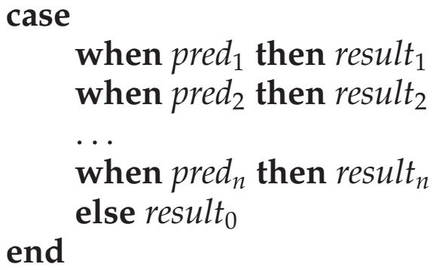
Case Statement for Conditional Updates
Same query as before: Increase all accounts with balances over $10,000 by 6%, all other accounts receive 5%.
update account set balance = case when balance <= 10000 then balance *1.05 else balance * 1.06 end

Slide 83
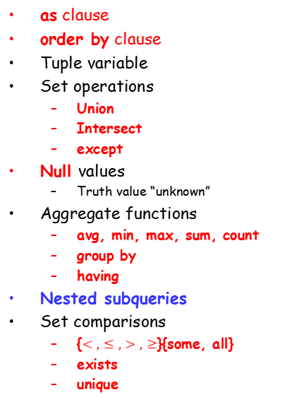
Review Terms
DDL:Data definition language
DML:Data manipulation language
Database schema
Database instance
Relation schema
Relation instance
Primary key
Foreign key
Referencing relation
Referenced relation
Query language
SQL query structure
select clause
from clause
where clause
Natural join operation
as clause
order by clause
Tuple variable
Set operations
Union
Intersect
except
Null values
Truth value “unknown”
Aggregate functions
avg, min, max, sum, count
group by
having
Nested subqueries
Set comparisons
{$<,≤,>,≥$}{some, all}
exists
unique
with clause
Scalar subquery
Database modification
Deletion
Insertion
Updating

Slide 84
Homework (Chapter 3)
Further Reading
Chapter 3
Exercises
3.8, 3.9 (选择其中一个)
3.15, 3.16, 3.17, 3.21 (选择其中两个)
Submission
Canvas上提交，上传单个PDF文件
Deadline: Oct 13 , 2023

Slide 85
End of Lecture 3

